Slide 1
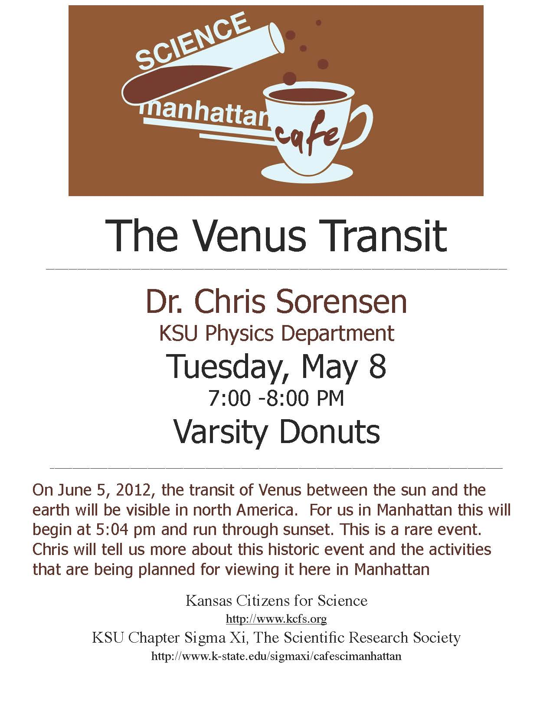

Slide 2
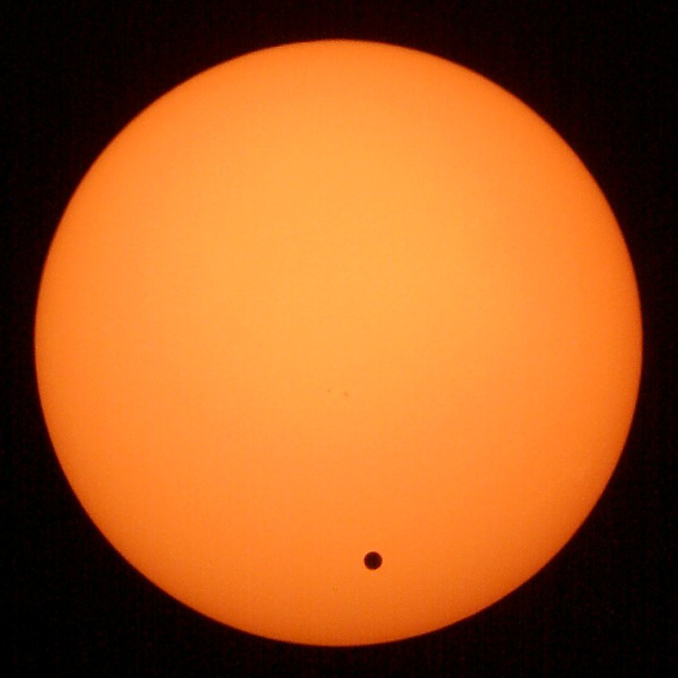
The 2012 Transit of Venus
Chris Sorensen
KSU Physics

Slide 3
A transit is when one astronomical body
passes in front of another relative to us,
and you can still see much of the other.

Slide 4
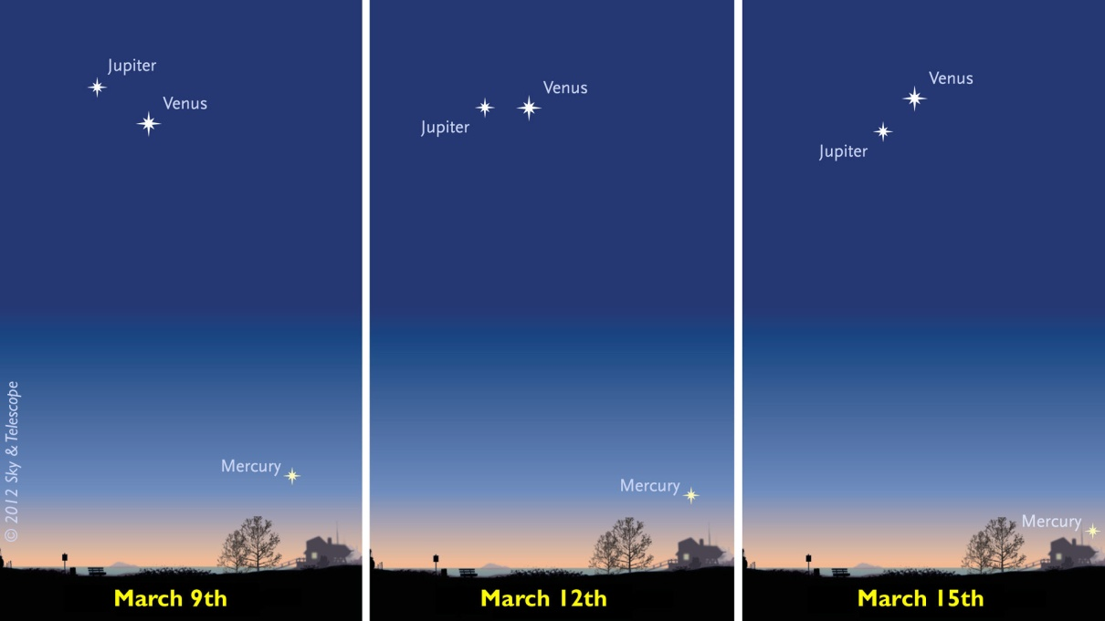
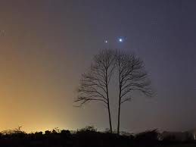
Venus and Jupiter in the west late winter 2012

Slide 5
Venus transits currently recur at intervals of
8, 105.5, 8 and 121.5 years.
Transits of Venus: 1601-2200
Date UT (Mid transit)
1631 Dec 07 05:19
1639 Dec 04 18:26
1761 Jun 06 05:19
1769 Jun 03 22:25
1874 Dec 09 04:07
1882 Dec 06 17:06
2004 Jun 08 08:20
2012 Jun 06 01:28
2117 Dec 11 02:48
2125 Dec 08 16:01
June 05 for us!

Slide 6
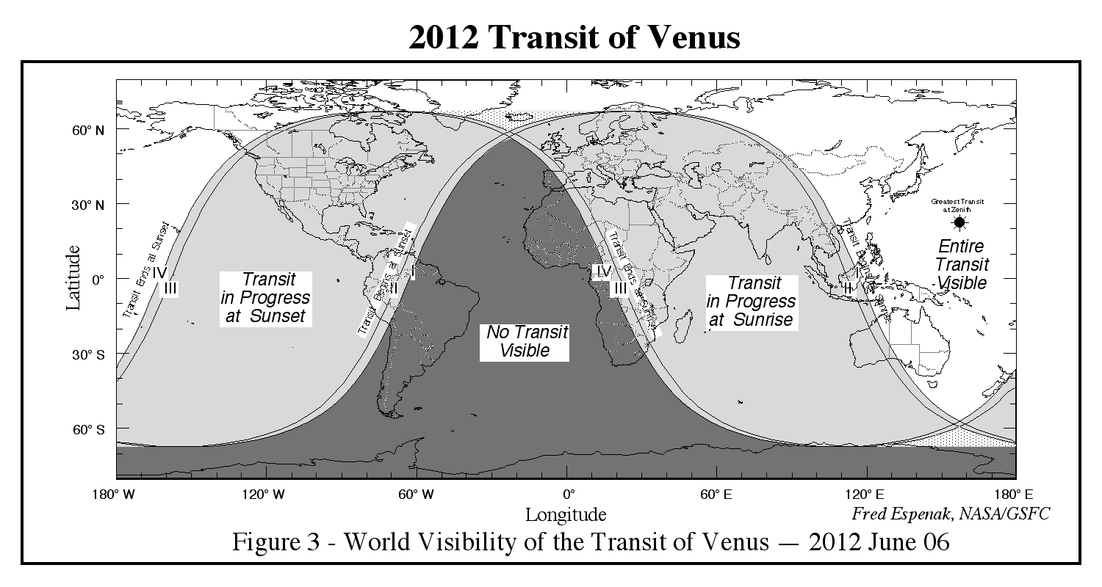

Slide 7
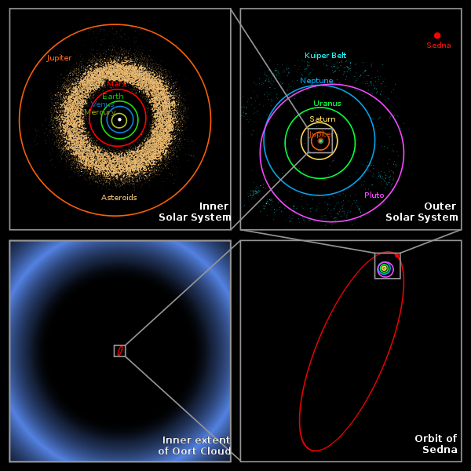
The Solar System

Slide 8
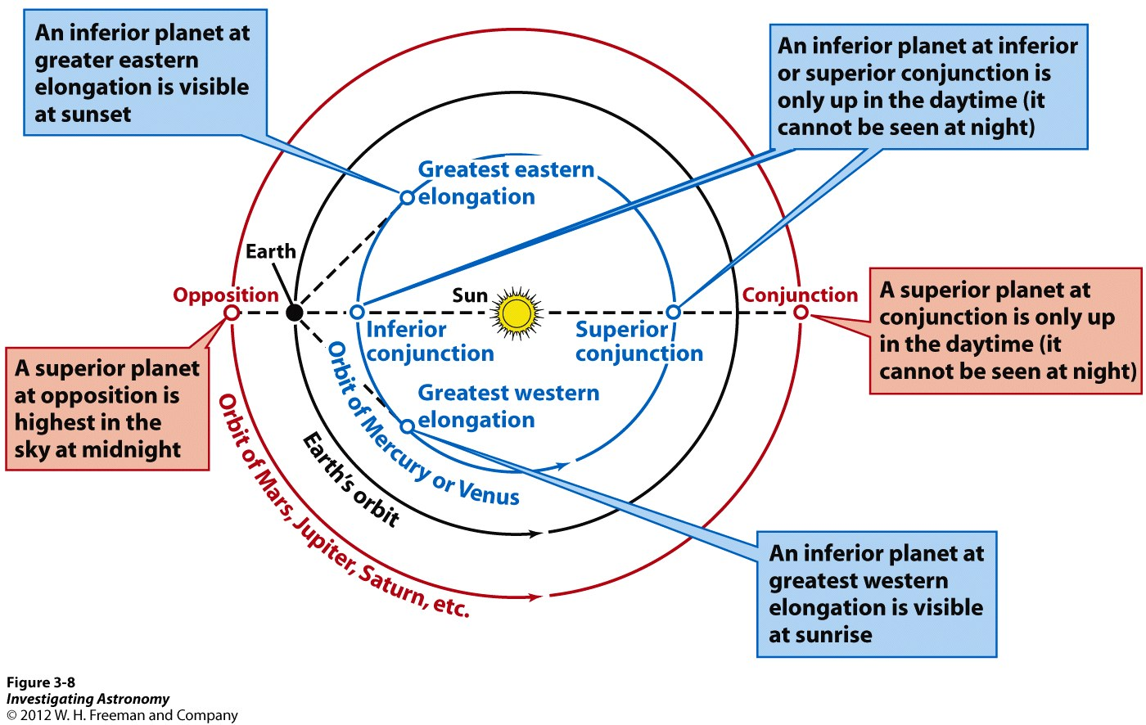
Apparitions of Venus

Slide 9
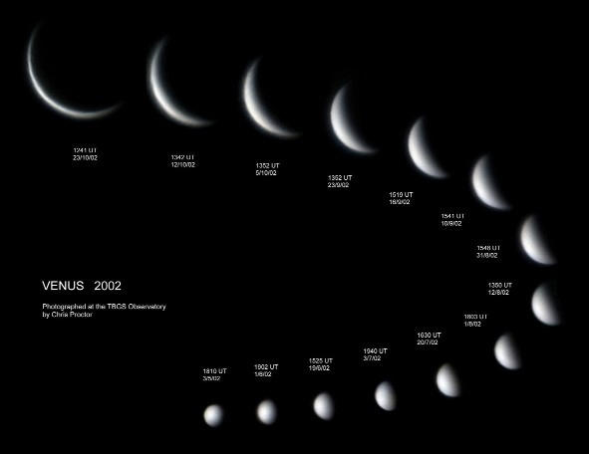
The phases of Venus

Slide 10
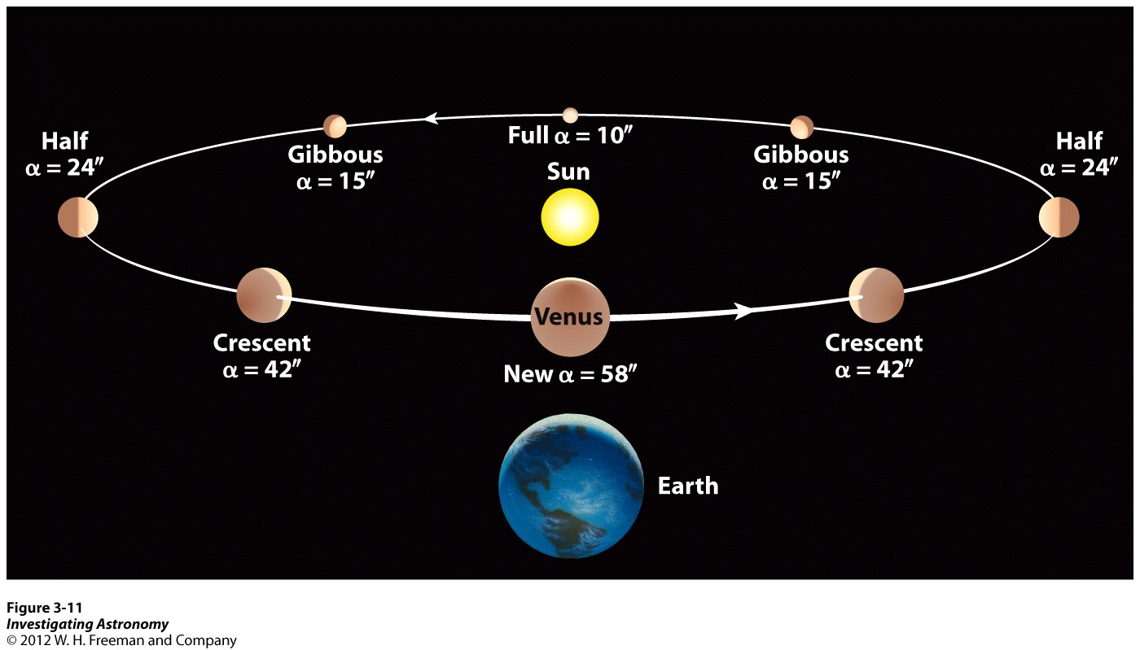
Venus’s orbit relative to the Earth

Slide 11
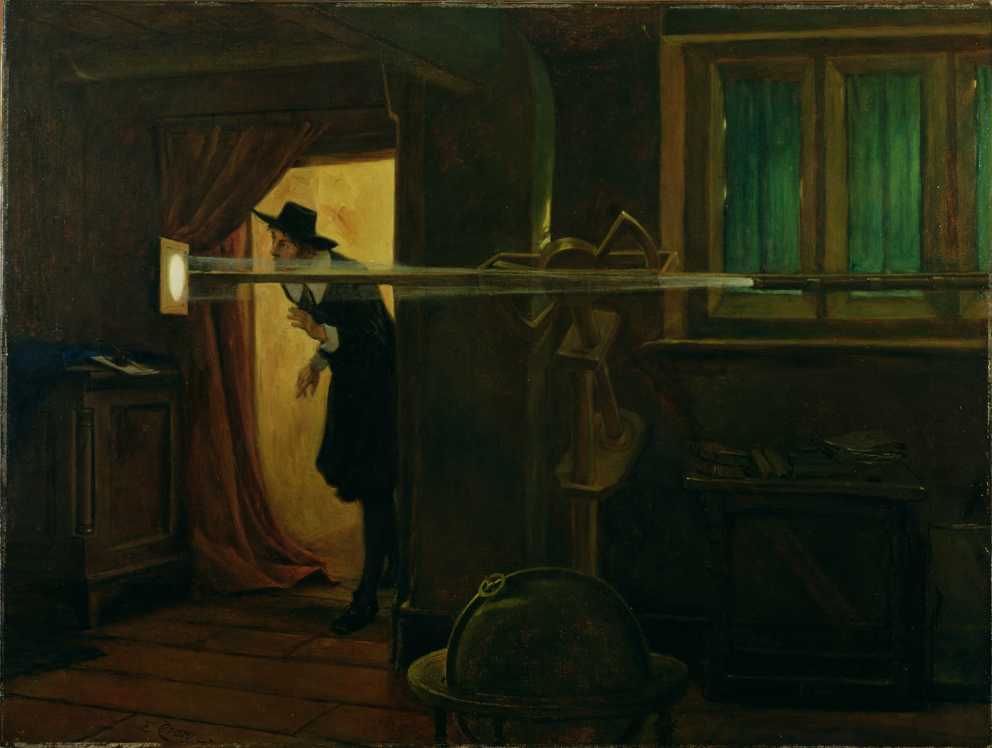
History
Kepler 1627 makes first prediction of transits for 1631 & 1639.
1631 at night in Europe.
1639 Jeremiah Horrocks in England corrected, somewhat,
Kepler’s calculations to find 3 pm Dec. 1639. He
and his friend Crabtree observed it.

Slide 12
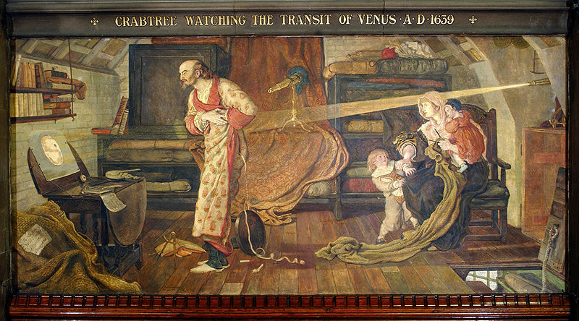

Slide 13
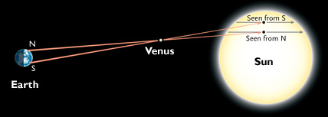
History (2)
Halley 1716 proposed using the transits, especially Venus,
to measure the Earth-Sun distance, i.e the Astronomical Unit
using parallax and Kepler’s 3rd Law,
(Period)² ~ (Distance)³
With the A.U., we can calculate all the planetary distances,
Hence the scale of the solar system, and all the planetary
Diameters and masses! Hence international space races
were spawned in the 18th and 19th centuries.

Slide 14
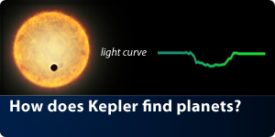
History (3)
With the 1761 transit, Mikhail Lomonosov at St. Petersburg
detected the refraction of solar rays around Venus thus
inferring the Venusian atmosphere.
Today
We now detect planets of distant stars when they transit
their stars with the Kepler Space Telescope.

Slide 15
Observing
NEVER LOOK DIRECTLY AT THE SUN
WITHOUT A PROPER SOLAR FILTER
OR AN INDIRECT METHOD

Slide 16
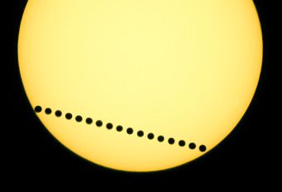
What you will see
Angular sizes:
Sun 32’ ≈ ½ degree; ¼ inch at arm’s length
Venus 58”≈ 1’ ≈ 1/60 degree; a period at arm’s length
a 33 to 1 ratio.
Total duration 6 hours 40 minutes.

Slide 17
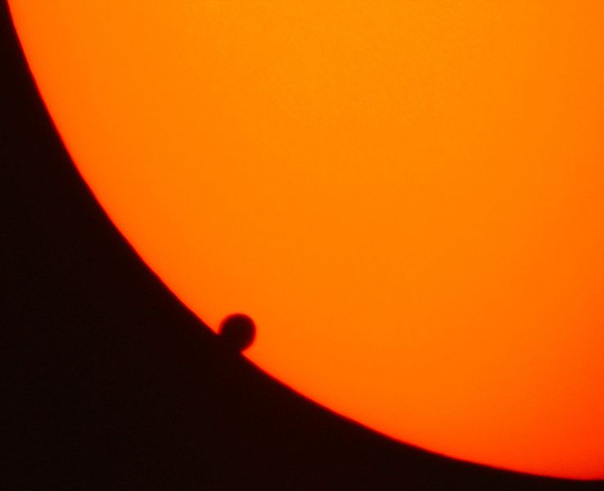
Black Drop Effect

Slide 18
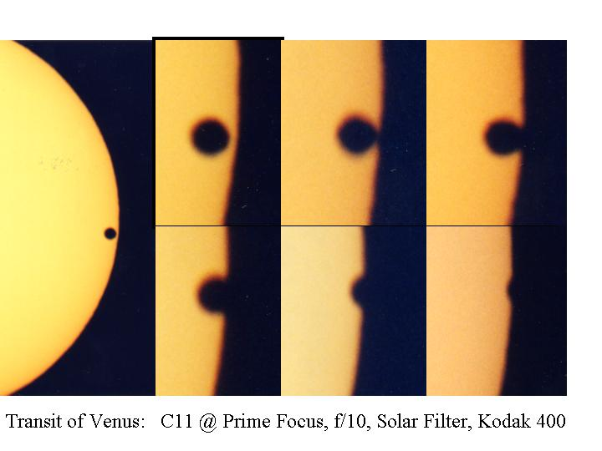
Black Drop Effect sequence

Slide 19
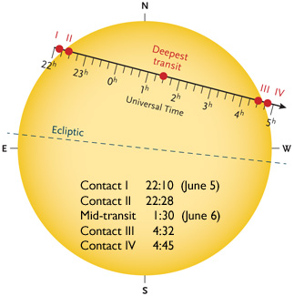
Timing
Contact 1 Manhattan
5:04:55 pm
Manhattan sunset 8:49 pm
CDT = UT – 5 hours. e/g. UT = 2200, CDT = 2200 – 500 = 1700 = 5:00 pm
June 5 Manhattan sunset 8:49 pm = 0149 June 6 UT.

Slide 20
Data for Manhattan KS
Contact 1 ………. 17:04:55 = 5:04:55pm
Contact 2 ………..17:22:54 (18 minutes)
Mid transit……… 20:27:12
Sunset …………….20:49 = 8:49pm

Slide 21
Solar filters
Be careful (still dangerous) and Venus “dot” hard to see.
# 14 welding glass
Solar Shades from astronomers without borders
10 ⁻⁴ = 0.01% attenuation

Slide 22
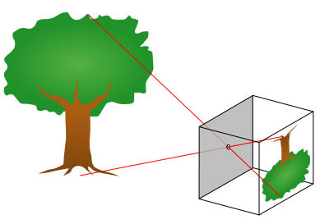
Pinhole camera
A one meter pinhole camera will make a sun image
8 mm in diameter with a Venus spot 8/33 = ¼ mm dia.
Two meters, 16 mm, etc.
Always in focus.

Slide 23
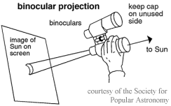
Telescope eyepiece projection
Mess around with distance and focus until focused

Slide 24
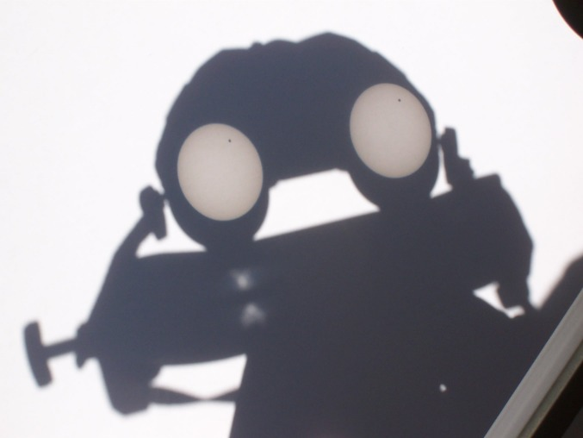

Slide 25
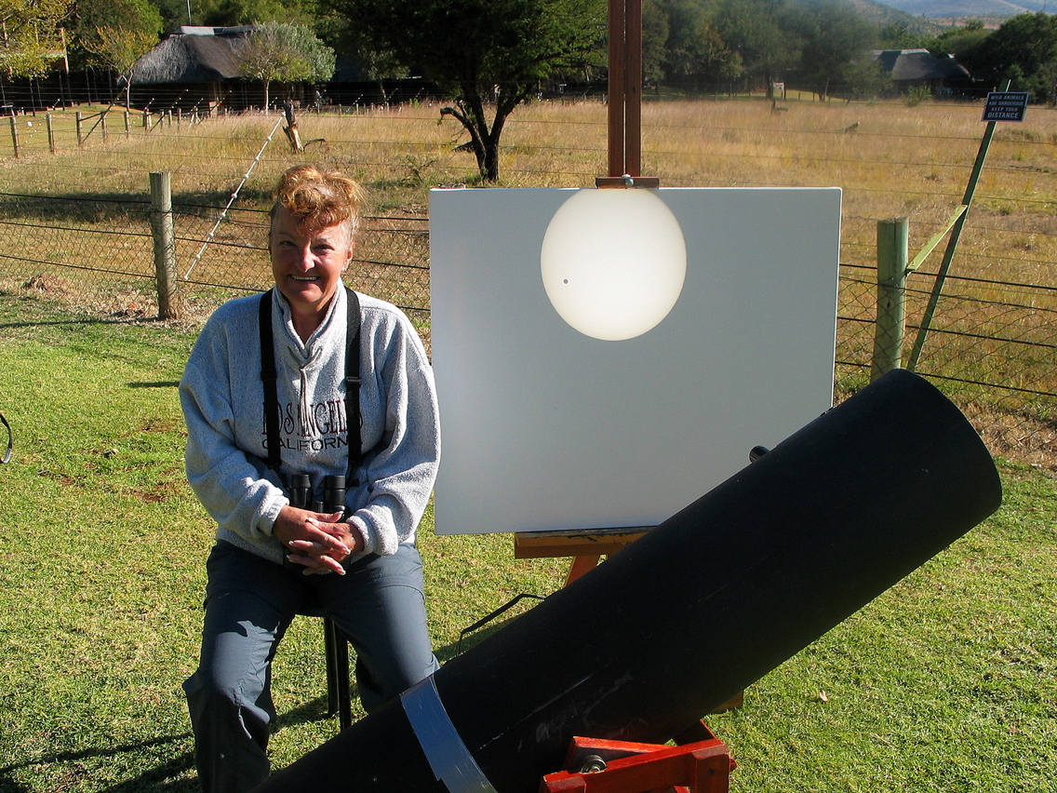
Eyepiece projection

Slide 26
Join us at KSU Physics
Ward Hall, west side
June 5, ca. 4:30 pm to sunset
A few 8” Schmidt Cass’s with solar filters
H alpha scope
Complements of KSU Physics and
the North Central Kansas Astronomical Society
www.nckas.org for updates.
Or contact me at sor@phys.ksu.edu

Slide 27
